Slide 1
Working with MSSQL Server
Code:G0-C#
Version: 1.0 Author: Pham Trung Hai CTD

Slide 2
Introduction
Duration: <No. of hours/ days>
Purpose: <Ultimate purpose of the course>
Audience: <Who should attend, Pre-requisites to attend the course>
Test: <Paper or online post assessment with pass mark of …%/ full participation/ …>

Slide 3
Objectives
You will be able to
Use Visual Studio for GUI based interactive access to a Microsoft SQL Server database.
Populate a table with data from an Excel worksheet.
Use sqlcmd for command line interactive access to a Microsoft SQL Server database.
Using either Visual Studio or sqlcmd
Create and delete tables.
Modify table definitions.
Insert new rows into tables.
Modify existing rows.
Retrieve and display table data.

Slide 4
Using Visual Studio 2008
Visual Studio 2008 includes database access functions.
View "Server Explorer"
Set up a Data Connection

Slide 5
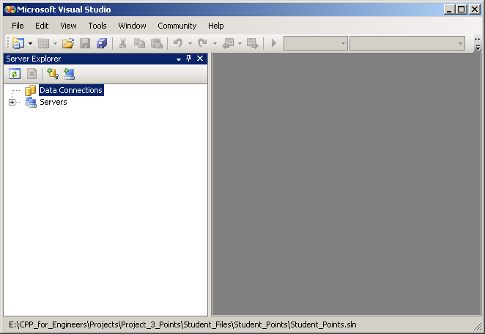
Data Connections in Visual Studio 2008
Right click on Data Connections and select Add Connection.

Slide 6
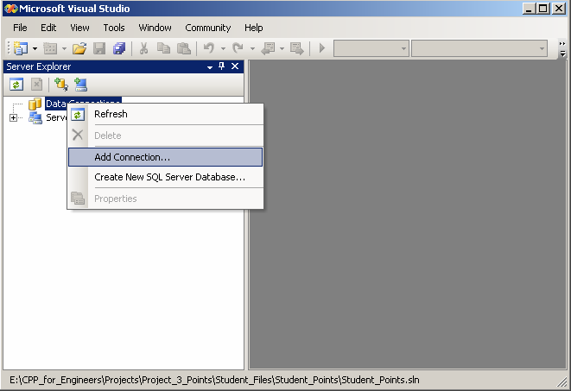
Adding a Data Connection

Slide 7
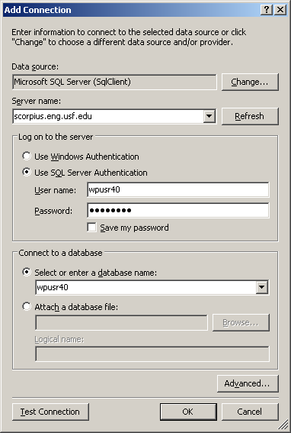
Adding a Data Connection
Your SQL Server Username
Your SQL Server Password

Slide 8
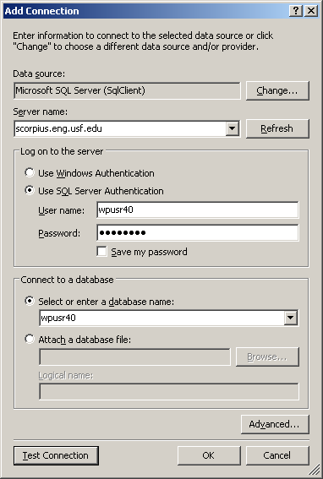
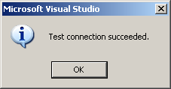
Test the Connection
Click here

Slide 9
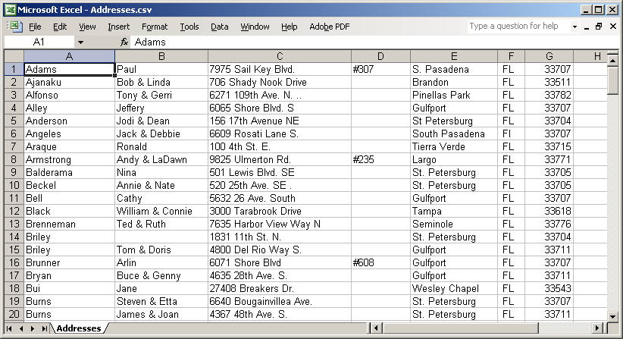
Adding a Table
We will create a new table to hold the addresses in file Addresses.csv.

Slide 10
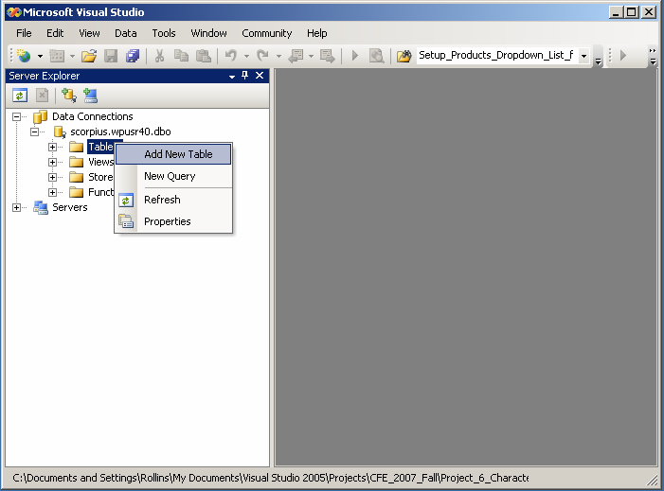
Adding a Table

Slide 11
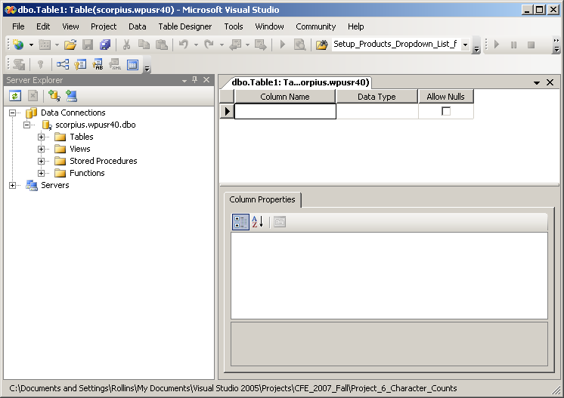
Adding a Table

Slide 12
Data Types
Common SQL Data Types
int
nvarchar(n) n = max number chars
char(n) n = number chars
decimal (p,s) p = total number of digits
s = number decimal places
datetime
Many more!

Slide 13
Setting an ID Field
It is good practice to include an ID field for every row.
Unique identifier
Not present in the Excel worksheet.

Slide 14
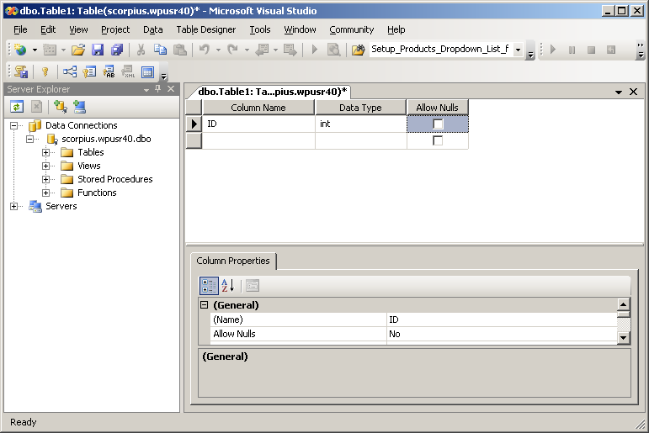
Setting an ID Field
We will designate this as the “Primary ID”

Slide 15
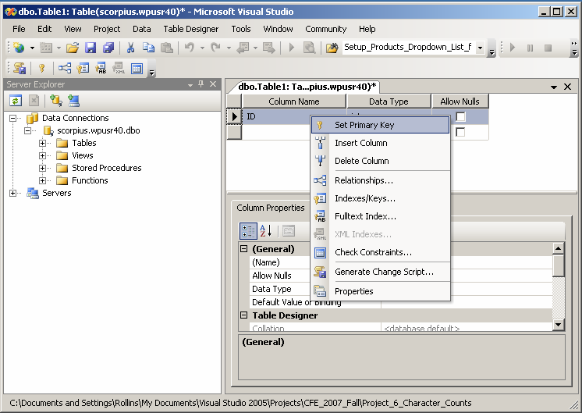
Setting the Primary Key
Right Click here
System ensures that the Primary Key is unique.

Slide 16
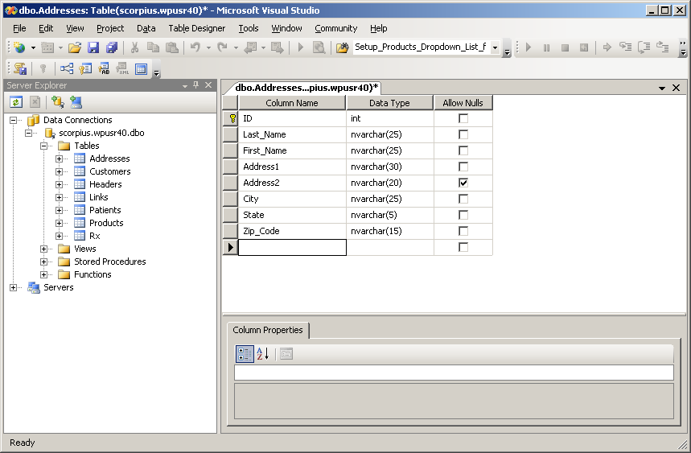
Define Other Columns

Slide 17
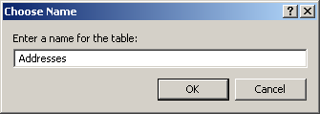
Save the Table Definition
Save

Slide 18
Table "Addresses" is Now Present

Slide 19
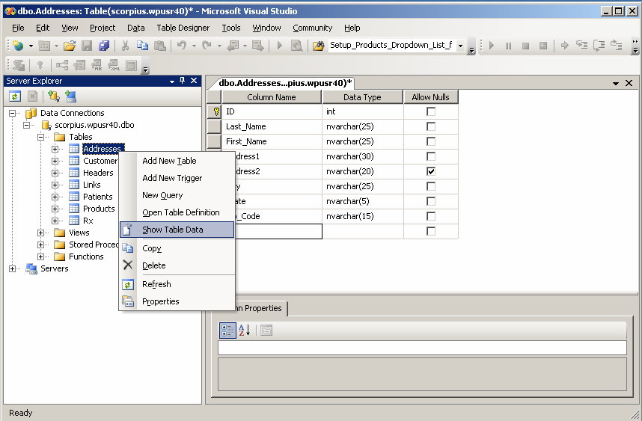
Viewing Table Data
Right click on Addresses and select “Show Table Data”.

Slide 20
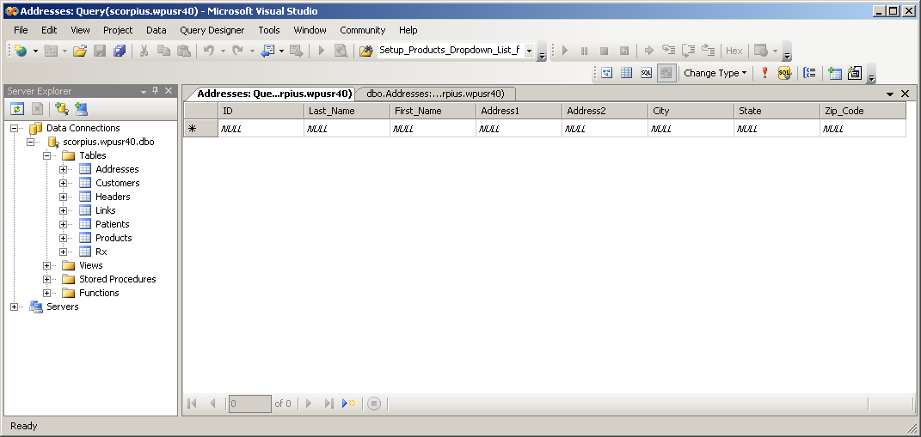
Viewing Table Data
Table is currently empty.

Slide 21
Populating a Table
Download file Addresses.csv from the Downloads area of the class web site:
http://www.cse.usf.edu/~turnerr/Web_Application_Design/ Downloads/Addresses.csv
Double click to open in Excel

Slide 22
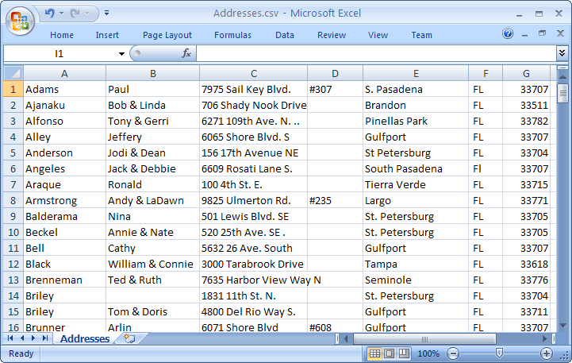
Excel Worksheet

Slide 23
Add ID Field
In order to use this data in the database table we need to add an ID field.
In Excel (2007) , right click on the column header “A” and select “insert” in the dropdown menu.
Adds a new column.

Slide 24
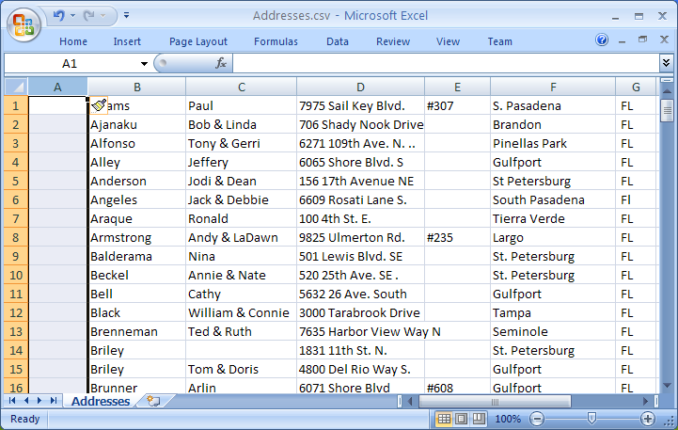
Adding an ID Column

Slide 25
Setting ID Values
Set the ID for the first row to 1.
Select ID on second row
Press =
Click the cell above (ID of the first row)
Click in the formula window and add “+1”
Formula window should now say =A1+1

Slide 26
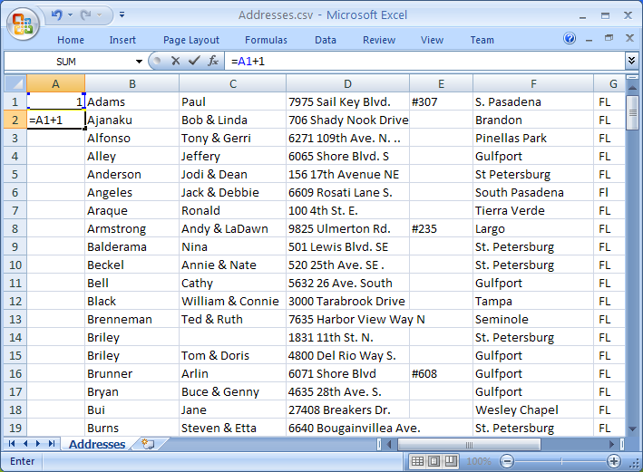
Setting ID Values
Press Enter

Slide 27
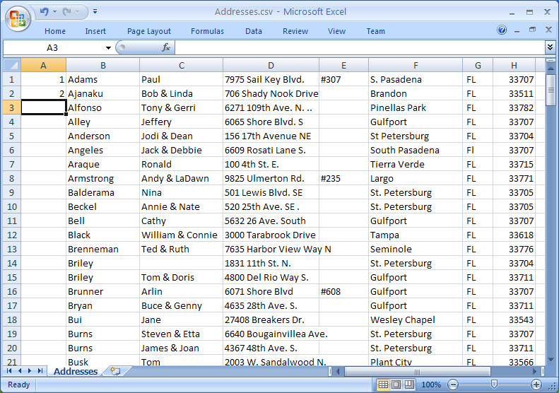
Setting ID Values

Slide 28
Setting ID Values
Copy the formula in 2A down into all the cells below it.
Click on 2A
Shift click on 175A
Press Ctrl-d (to copy Down)
Should now see consecutive numbers 1 – 175 in the first column

Slide 29
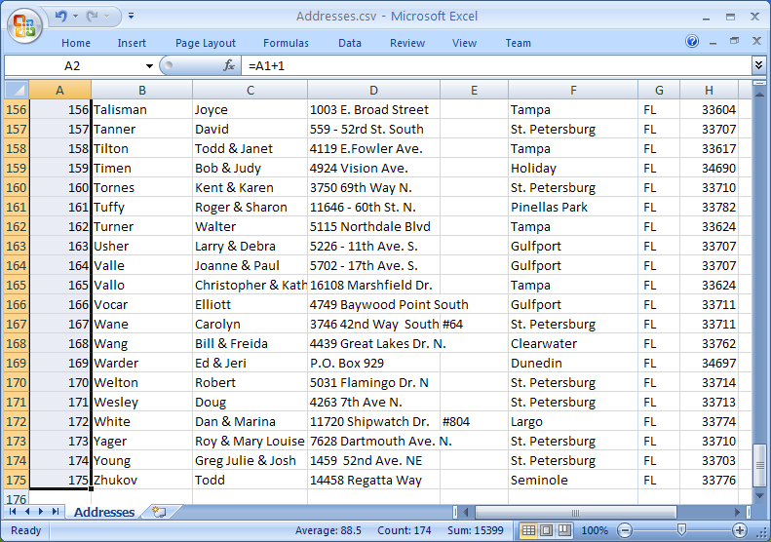
Addresses with IDs

Slide 30
Populating the Database Table
We will use the contents of this Excel worksheet to populate the Address table in the database.
Click inside the worksheet, then press Ctrl-A to select all.
Press Ctrl-C to copy the entire worksheet to the clipboard.

Slide 31
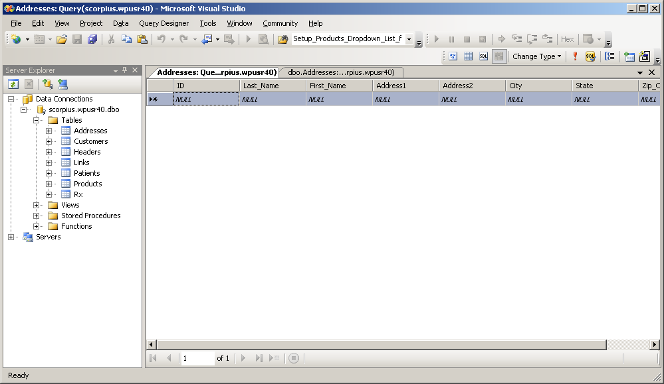
Populating the Database Table
Click here to select all of the table.
Press Ctrl-V to paste the clipboard into the table.
(This may take a while to complete.)

Slide 32
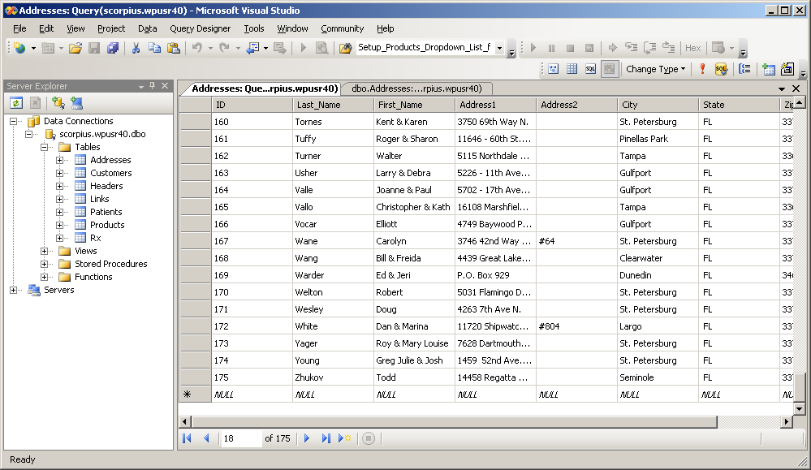
The Table is Populated

Slide 33
The sqlcmd Utility
Command line utility for MS SQL Server databases.
Previous version called osql
Available on classroom and lab PCs.
In Windows command window
Connect to a Database Server
Enter SQL commands on the command line.
Results output to the console.

Slide 34
Getting and Installing sqlcmd
Included with Management Studio Express.
Free download from Microsoft,
Documentation available in SQL Server 2005 Books Online
Free download from Microsoft.
In Visual Studio 2008, search for sqlcmd.

Slide 35
The SQL Language
The following slides demonstrate SQL commands using the sqlcmd program.
Remember SQL is used everywhere we interact with a database server:
Command line
Database management programs
Our own programs

Slide 36
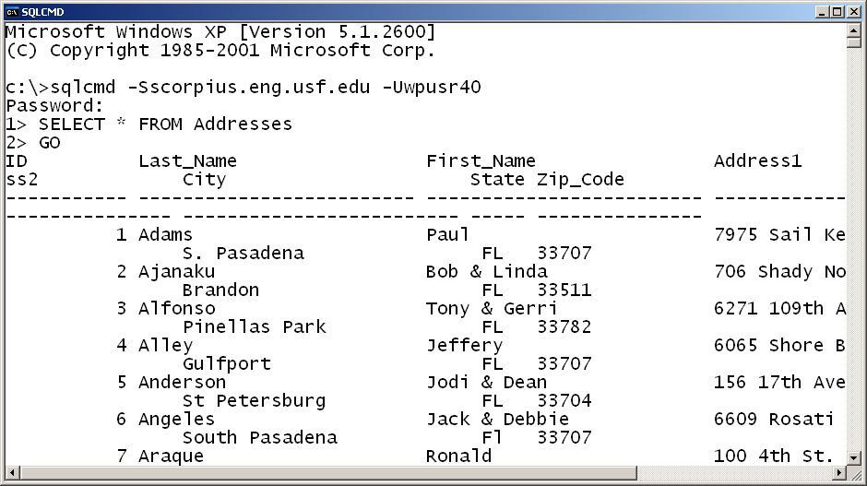
Using sqlcmd
The Server
My Username
Password entered here
Execute commands in buffer

Slide 37
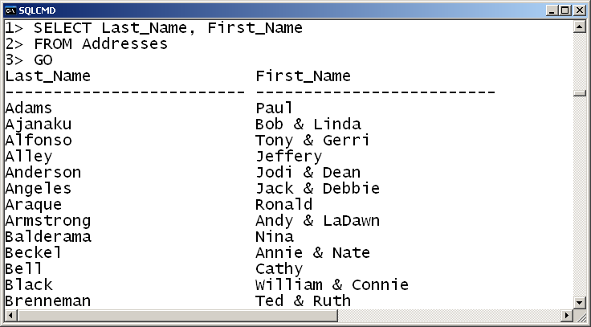
SQL Command Line Example
View a subset of the columns.

Slide 38
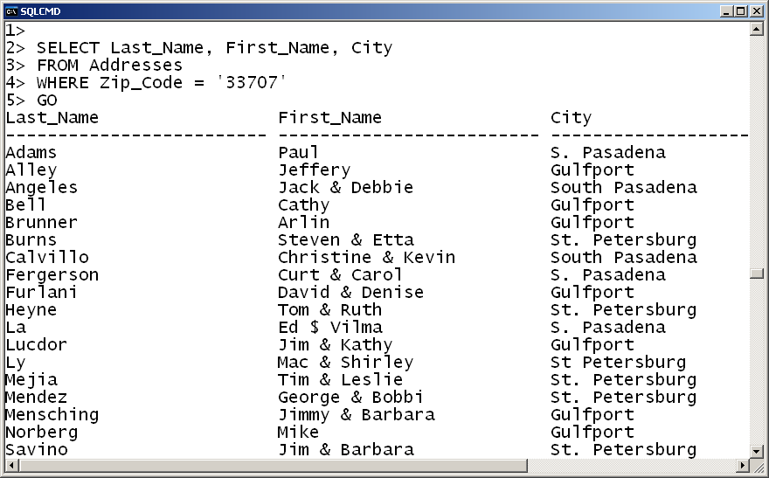
Retrieve Specific Entries
Find all addresses with zip code 33707

Slide 39
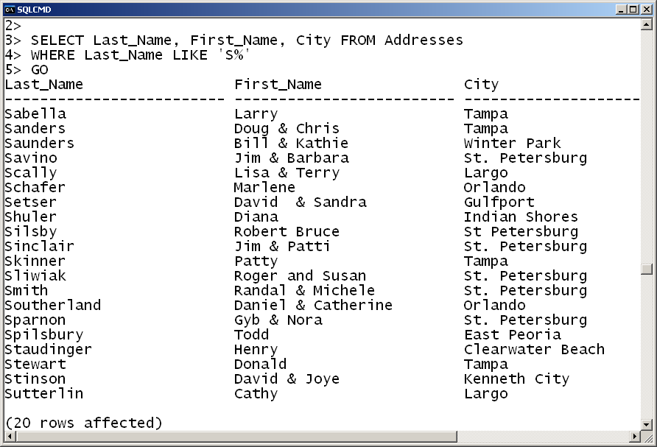
Wildcard Selection
Find all addresses with last name beginning with S

Slide 40
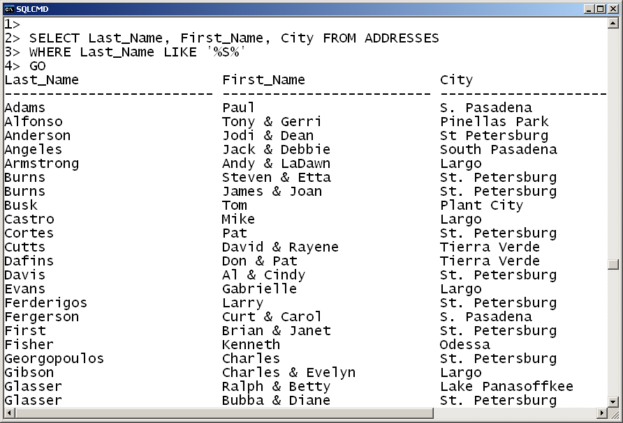
Wildcard Selection
All addresses with last name containing an s

Slide 41
Case Sensitivity
Typically SQL commands and keywords are not case sensitive.
Data is case sensitive
Characters are stored as upper case or lower case.
Sorting order is a mode
Default is not case sensitive
Search comparisons same as sorting order.

Slide 42
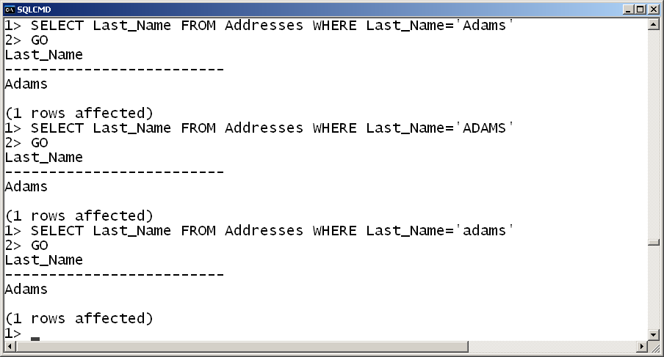
Case Sensitivity

Slide 43
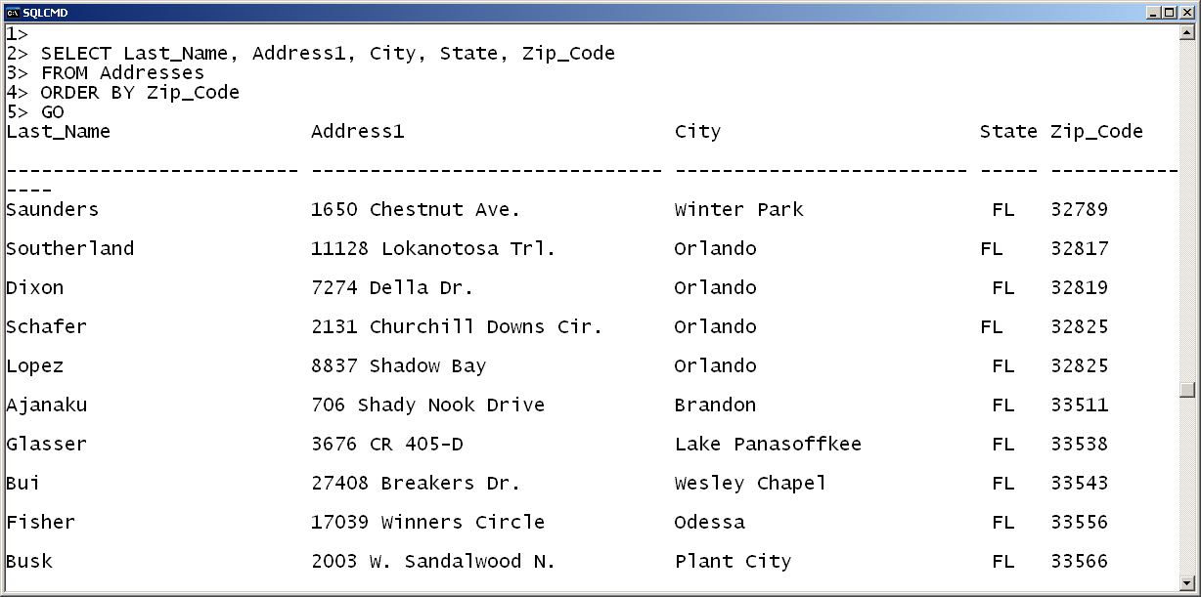
Sorting the Output
Zip_Code is a string. So sort is lexicographic, not numeric.

Slide 44
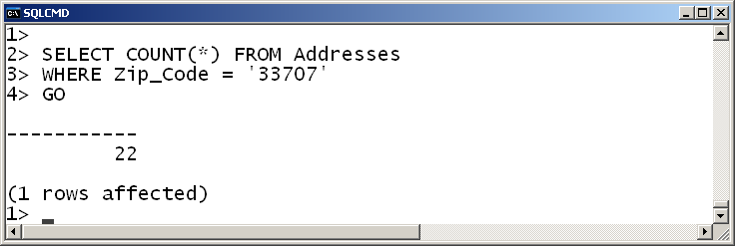
Counting Rows
How many addresses are there with zip code 33707?

Slide 45
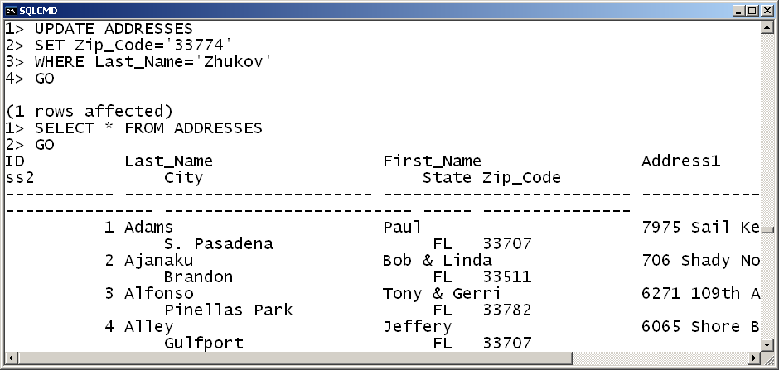
Updating Records

Slide 46
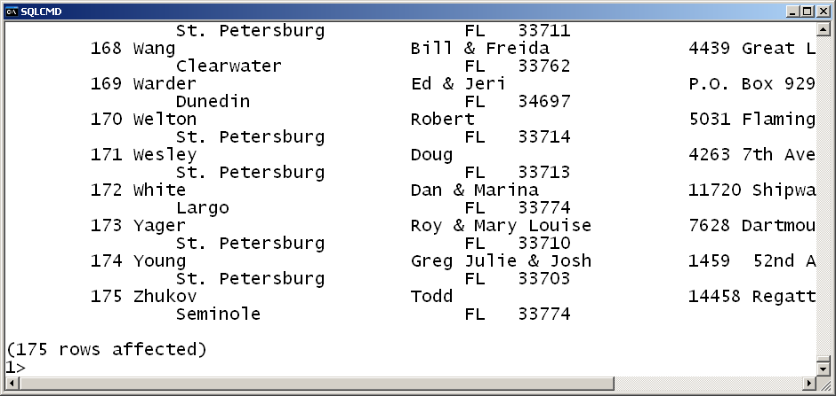
Updating Records

Slide 47
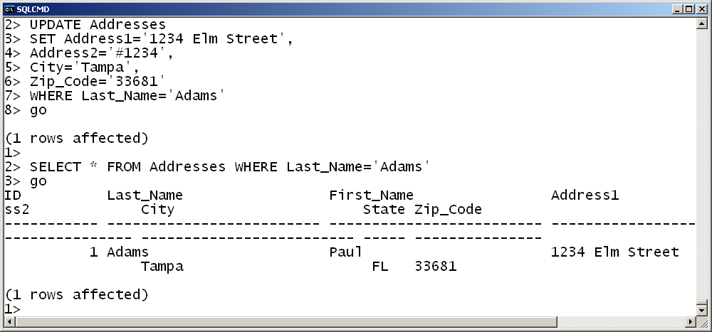
Updating Multiple Fields

Slide 48
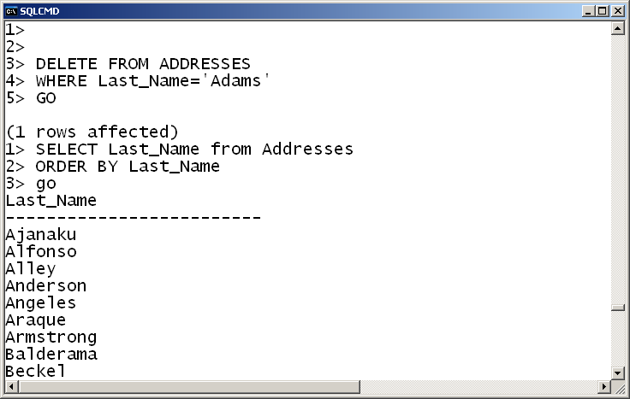
Deleting a Record

Slide 49
SQL Commands in Visual Studio
We can also use Visual Studio to issue arbitrary SQL commands to the server.
On the Data menu select New Query

Slide 50
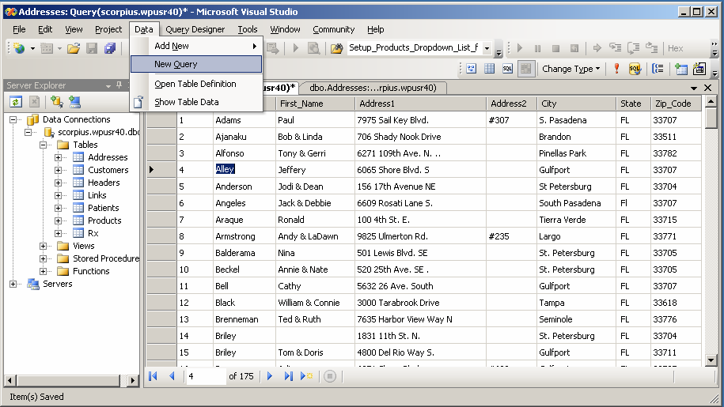
SQL Commands in Visual Studio

Slide 51
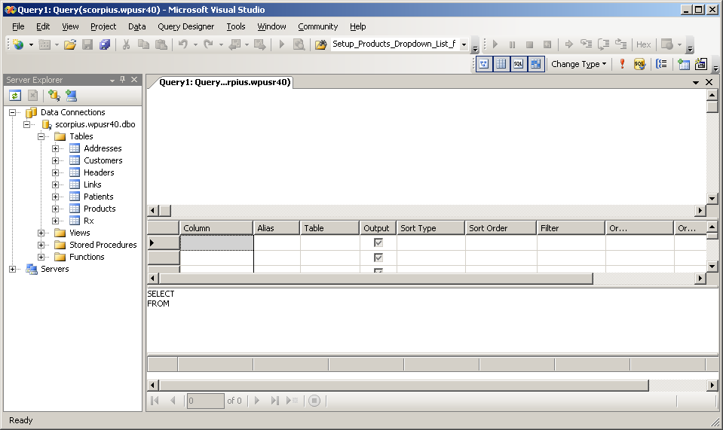
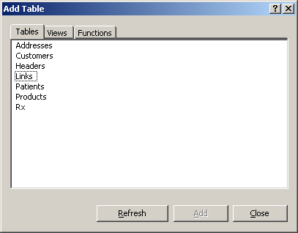
SQL Commands in Visual Studio
Click here

Slide 52
SQL Commands in Visual Studio
Enter SQL command here.

Slide 53
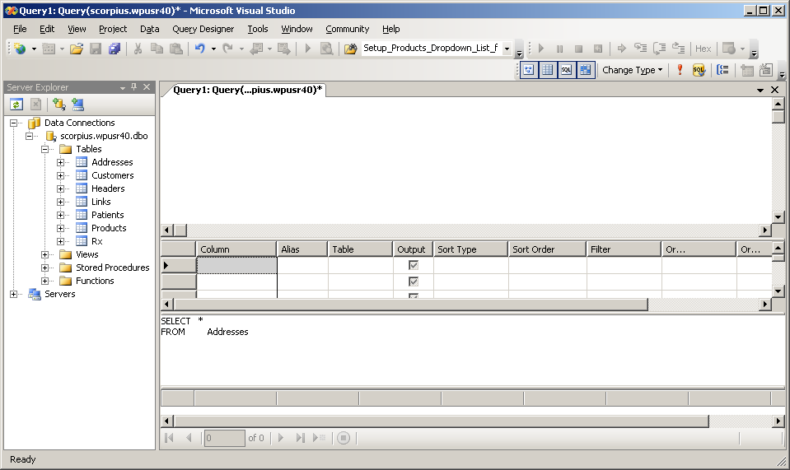
SQL Commands in Visual Studio
Click here to execute the command.

Slide 54
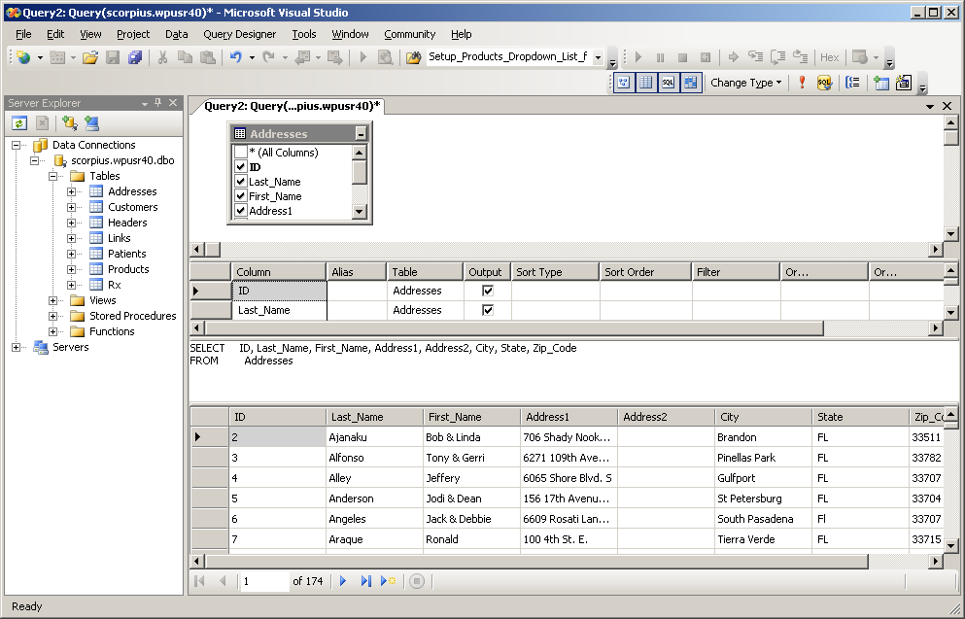
SQL Commands in Visual Studio
Results appear below the Query window.

Slide 55
Learning SQL
Many books available
One that I recommend:
Teach Yourself SQL in 24 Hours (Third Edition)
Ryan Stephens and Ron Plew, SAMS, 2003
Lots of information on the web
A sampling:
http://en.wikipedia.org/wiki/SQL
http://www.w3schools.com/sql/default.asp
http://db.grussell.org/ch3.html

